Slide 1
Crowd Fraud Detection in Internet Advertising
Tian Tian¹ Jun Zhu¹ Fen Xia² Xin Zhuang² Tong Zhang²
Tsinghua University¹ Baidu Inc.²
Notes:
■Good Morning everyone, I’ll give a talk about our recent work on Crowd Fraud Detection in Internet Advertising. algorithmic

Slide 2
Outline
Motivation
Characteristic Analysis
Detection Methods
Empirical Results
Conclusion
Notes:
■This talk is composed by five parts. Now I will start from the motivation part.

Slide 3
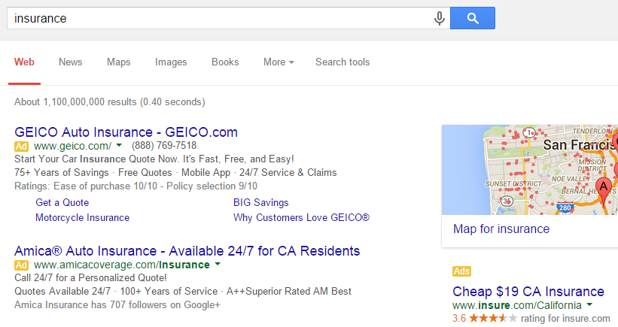
About Internet Advertising
Charged by the volume of clicks
Notes:
■First, what is Internet advertising? For example, on the search engine, when you search a query, the website will retrieve relevant information as well as the advertisements on the result page.
■When you click one of them, the owner advertiser will be charged by search engine.
■Usually these advertisers are charged by the volume of clicks.

Slide 4
What is Crowd Fraud?
Rise the risk of fraud.
Malwares, Auto clickers..
A group of People
A group of people driven by economic benefits work together to increase fraudulent traffic on certain targets.
Notes:
However, This kind of pay-per-click mechanism increases the risk of fraud because malicious ones can easily raise traffics on competitors.
■Conventional advertising frauds usually start from computer programs, such as malwares and auto clickers. These click frauds have been well studied.
■Recently, a new type of fraud clicks through a group of people appeared. Attackers publish click tasks on malicious crowdsourcing platforms, then A group of web workers driven by economic benefits work together to increase fraudulent traffic on the targets. We call this phenomenon crowd fraud.

Slide 5
What’s new?
 | Crowd Fraud | Conventional
Number of workers
Traffic per person
Behavior pattern?
Have normal clicks?
Large
Few
Small
Large
Random
Regular
Yes
No
Notes:
■Crowd fraud differs from automatically generated fraudulent behaviors in several aspects.
■They have a larger number of workers involved than conventional ways,
■and smaller fraudulent traffics conducted by each crowd fraud worker,
■Their behavior pattern looks random
■Moreover, each crowd fraud worker may have normal click behaviors. All these differences make the conventional detection methods invalid for crowd fraud.

Slide 6
Outline
Motivation
Characteristic Analysis
Detection Methods
Empirical Results
Conclusion
Notes:
■Now we move to the characteristic analysis.

Slide 7
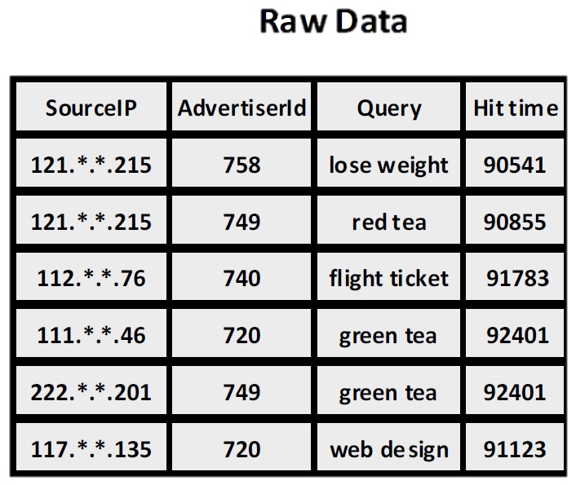
Characteristic Analysis
we collect click datasets of both normal traffics and crowd fraud traffics.
Notes:
■In order to find group behavior patterns of crowd fraud, we collect click datasets of both normal traffics and crowd fraud traffics. The raw data are composed of many click logs, each of them have attributes like source IP, advertiser ID, search query and hit time. After analysis, we find three main characteristics of crowd fraud.

Slide 8
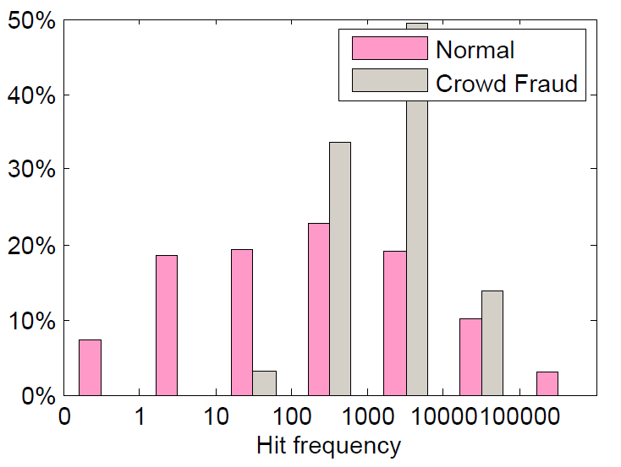
Moderateness
the hit frequencies of crowd fraud target queries will be neither too small nor too large.
Aim to raise traffic
human efficiency is limited
Notes:
■The first is moderateness. we found that the hit frequencies of crowd fraud target queries will be neither too small nor too large. This is the histogram of target queries hit frequency of crowd fraud traffics and normal traffics. We can see most crowd fraud hit frequencies are in the middle range.
■It will not be too small because the aim of crowd fraud is to raise traffics.
■It will neither be too large because human efficiency is usually limited.

Slide 9
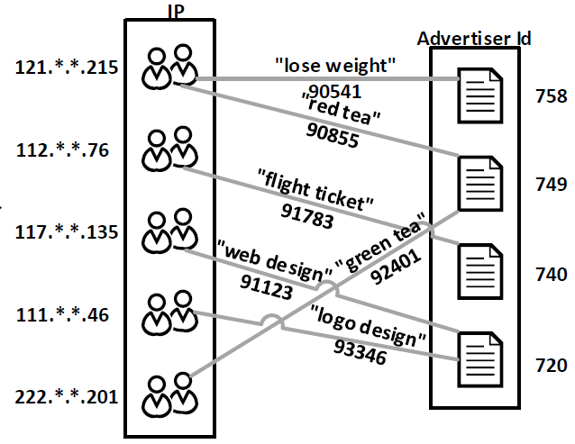
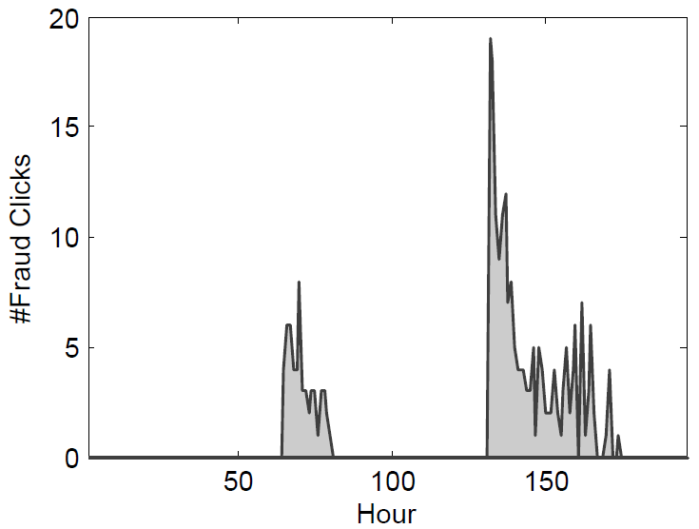
Synchronicity
Target Synchronicity
Surfers can be grouped into coalitions; each coalition attack a common set of advertisers
Temporal Synchronicity
most clicks toward an advertiser happen within common short time period
Notes:
■The second characteristic is synchronicity.
■Its first part is target synchronicity. Since crowd fraud starts from malicious crowdsourcing platforms, these surfers can usually be grouped into coalition. Workers on the same platform tend to accomplish similar tasks published on this platform, so they are likely to attack a common set of advertisers.
■The second is the temporal synchronicity. which means that most clicks toward an advertiser happen within common short time period. We think the busy time period may be related to the task's publishing time on the malicious crowdsourcing platform.

Slide 10
Dispersivity
Crowd fraud surfers may search unrelated queries
Normal:
Eye cream, Cleansing milk, Skin care
Same Business Domain
Crowd Fraud:
Beach BBQ, Hospital, Royal jelly
Different Business Domain
No Real Information Demand
Notes:
■The third characteristic is dispersivity. It means that crowd fraud surfers may search and click a series of unrelated queries in a short time period.
■For example, a normal surfer may search queries lick eye cream, cleansing milk, and skin care. They are all from a same business domain.
■While for a crowd fraud surfer, he may search Beach BBQ, hospital and royal jelly, these queries are from three different business domain.
■This phenomenon may because crowd fraud surfers have no real information demand. They don’t care what they are really searching.

Slide 11
Outline
Motivation
Characteristic Analysis
Detection Methods
Empirical Results
Conclusion
Notes:
■Now we are ready for our detection methods.

Slide 12
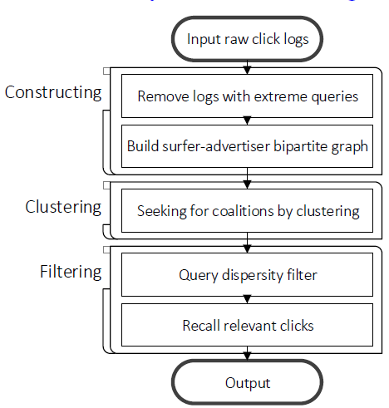
Crowd Fraud Detection
Based on the above characteristics, we propose a
Crowd Fraud Detection Method of Search Engine
Notes:
■Based on the above characteristics, we propose a crowd fraud detection method of search engine advertising. This method are composed by three stages, constructing stage, clustering stage and filtering stage. Now I’ll introduce them one by one.5276

Slide 13
Construction Stage
Remove irrelevant data based on moderateness more than 70%
Reorganize the remain logs into a surfer-advertiser inverted list
Click history
{Ader ID: 26 }
IP: abc,{ }
,time: 456
,{Ader ID: 64,time:136}
,…
Click event
Notes:
■In the construction stage, the first step is to remove irrelevant data. According to the moderateness condition, queries with extreme hit frequencies are barely crowd fraud, so we can choose a lower bound and an upper bound, and find queries with hit frequencies outside this range. Then all click logs correspond to these queries can be removed. By this step we can remove more than seventy percent data.
■The next step is to reorganize the remain logs into a surfer-advertiser inverted list, this inverted list is indexed by click source IP. We show an example of a inverted list line in this box.
■for each IP, the record contains its click history.
■Each click history is composed by many click events.
■And each click event has two attributes, the click target advertiser ID
■and the hit time.
■All the click events of this IP form its click history. This inverted list will be used as the input of the next stage.

Slide 14
Clustering Stage——Formulation
Detect malicious surfer coalitions in which all surfers have similar behavior patterns
Click histories
Notes:
■Then we come to the clustering stage. According to the synchronicity condition, crowd fraud surfers can usually be grouped into coalitions, all surfers in a same coalition will have similar behavior patterns. So in this stage, our goal is to detect malicious surfer coalitions in which all surfers have similar behavior patterns.
■Click history of a surfer is very suitable to represent the behavior pattern. So we define the synchronization similarity of two surfers based on their click histories.

Slide 15
Clustering Stage——Formulation
Sync-similarity numerically equals to the number of targets shared (and happened in the same time period) by two click histories.
$$τ=24$$
IP: a,{ {Id:12,Time:135}, {Id:13,Time:45}, {Id:28,Time:97}}
|135-122|<24
|45-135|>24
IP: b,{ {Id:12,Time:122}, {Id:13,Time:135}, {Id:21,Time:15}}
Sync-similarity=1
Sync-similarity=0
Notes:
■the Sync-similarity numerically equals to the number of common targets shared by the two click histories, Here a common target not only means same target id, but also means that the click events of two surfers on this target are happened in a same time period. We can make the definition more clear by an animation.
■Suppose the click histories of two surfers are like this. We choose the time radius as twenty-four, and all click events are sorted by target ID.
■We first check the first pair of events, their target ID are same
■and the absolute value difference between their hit times is smaller than twenty-four. So this pair meets our conditions,
■we increase sync-similarity by one.
■Then move to the next pair. Their target ID are the same,
■but the difference between their hit times is larger than twenty-four, so these two events are not similar.
■Then for the next pair, their target IDs are different, so obviously they are not similar.
----- 会议笔记(15/5/14 13:27) -----
lianguanyixia

Slide 16
Clustering Stage——Formulation
We define Coalition center μ, with the same form of Click history.
Looks like clustering!
But Number of coalitions is very hard to decide in advance
Notes:
■To formulate the coalition detection problem, we further define a coalition center miu for each coalition, it has the same form as the click history, so we can calculate the sync-similarity between a coalition center and a click history.
■After these definitions, our problem is to find surfers and coalitions that satisfy this synchronicity condition: For kth coalition and every surfers in this coalition, the sync-similarities between surfers’ click histories x-i and the center miu-k should be larger than a similarity threshold T.
■This problem looks like a clustering problem. However, the number of total coalitions is very hard to decide in advance. So this problem cannot be solved by clustering algorithm like K-MEANS.

Slide 17
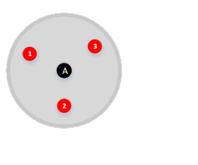
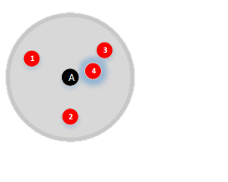
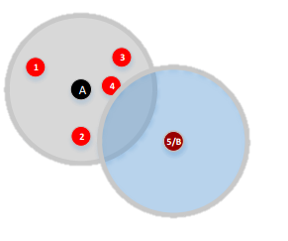
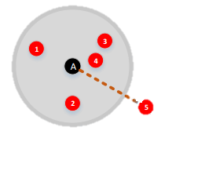
Clustering Stage——Algorithm
Inspired by nonparametric clustering DP-means
Each normal surfer as an one-member-coalition
1 Update = Assignment Step + UpdateCenter Step
Notes:
■Inspired by the nonparametric clustering algorithm DP-means, we regard each normal surfer as an one-member-coalition, then we give a nonparametric objective for our detection problem.
■This objective have two part, the loss function part is same as k-means, but the total number of coalitions K is also a variable to learn, it appears in the regularization term. By solving this problem, we can learn the number of clusters, and detect coalitions that satisfy synchronicity condition.
■The solving algorithm is also similar as K-means, each update iteration are composed by assignment step and updateCenter step. The main trick is the assignment step, Here we show an animation.
■Suppose we have already assign three point into a cluster A
■when we process the next point, we calculate the sync-similarity between this point and its most similar cluster center, if this similarity larger then the threshold lambda_w. We assign this point into its most similar cluster.
■But if for the next point, the sync-similarity between the point and its most similar cluster center is still smaller than the threshold, we build a new cluster which use this point as its center, and assign the point into the new cluster. This updating can grantee to converge to a local optimum of our objective function.

Slide 18
Filtering Stage
Remove false alarm clusters (e.g. games ad.)
False alarm clusters usually focus on one business domain, which invalid the dispersivity.
Use query-advertiser inverted list!
Query: game,{Advertiser Id: 2,19,79,184,336,…}
Query: game,{Advertiser Id: 2,19,79,184,336,…}
Center: k,{ Advertiser Id: 2,19,66,79}
Center: k,{ Advertiser Id: 2,19,66,79}
At least 3 Advertisers in this coalition share same business domain!
Notes:
■The next stage is the filtering stage. After clustering stage, we have found many suspicious clusters. But many of them are false alarm clusters, we need to remove them.
■Since false alarm clusters usually focus on only one business domain, which invalid the dispersivity. we can just count the number of business domain of each cluster center. However, find the corresponding business domain of all advertisers need a lot of external knowledge. Here we propose an alternative way to use the query-advertiser inverted list.
■Based on the click dataset, we collect all advertiser ids correspond to a same query, game for example, so these advertisers are very likely to have same business domain.
■Then we compare it with the advertiser ids in the coalition center.
■If three Id appear in both two set. We can say at least three advertisers in this coalition share same business domain. So we can find false alarm clusters based on this method.

Slide 19
Parallelization
The real world click logs can be very large, a serial algorithm may cannot be used. So we develop a parallel implementation to make it practical in real scenarios.
Its difficulty is in the Assignment step of the nonparametric clustering algorithm.
Notes:
■Now we have finish our serial algorithm. However, since the real world click logs can be very large, a serial algorithm may cannot be used. So we develop a parallel implementation to make it practical in real scenarios.
■The difficulty of the parallelization is in Assignment step of the nonparametric clustering algorithm. Since it will dynamically generate new cluster centers.

Slide 20
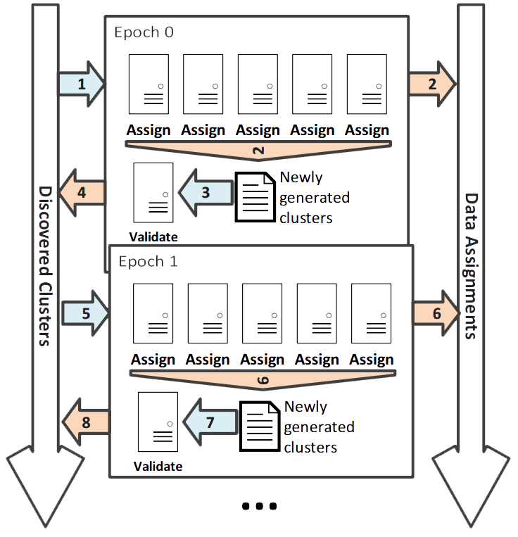
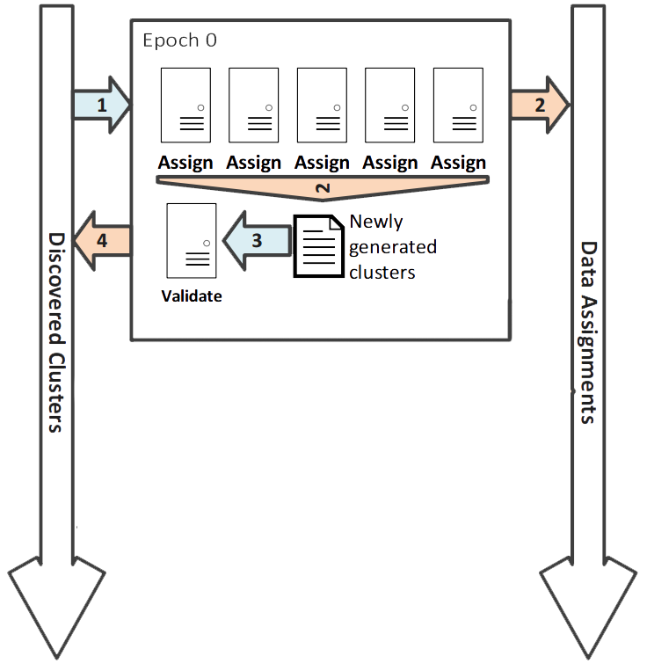
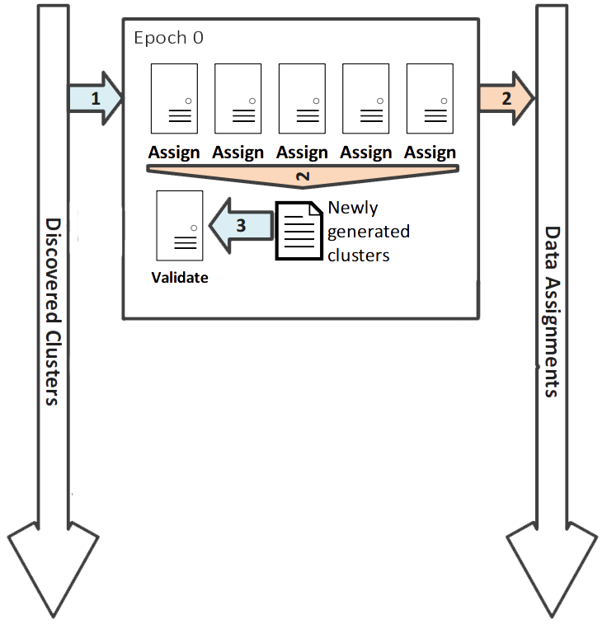
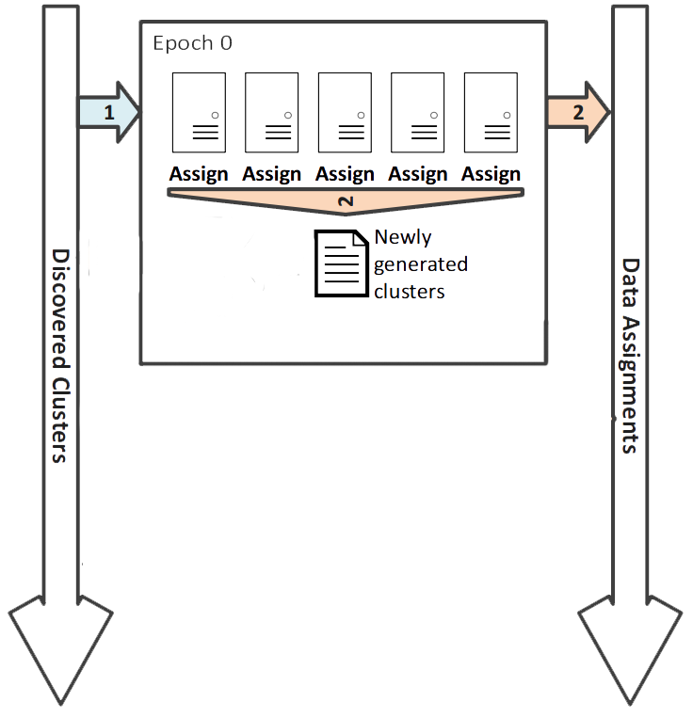
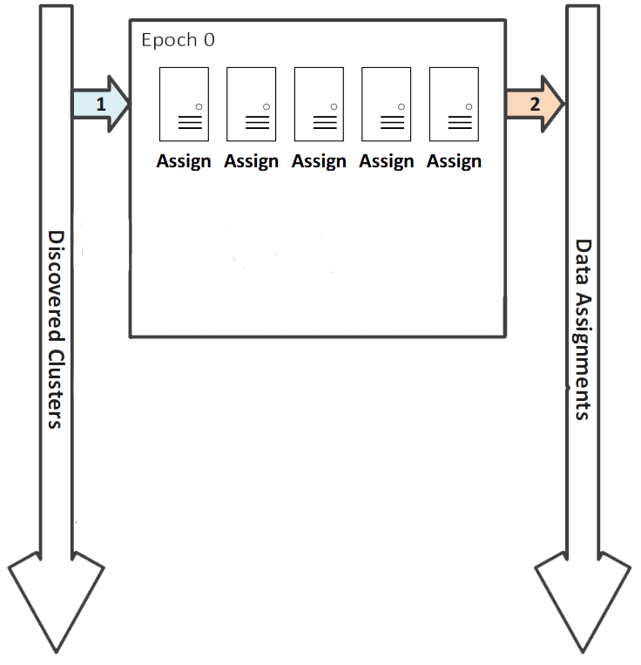
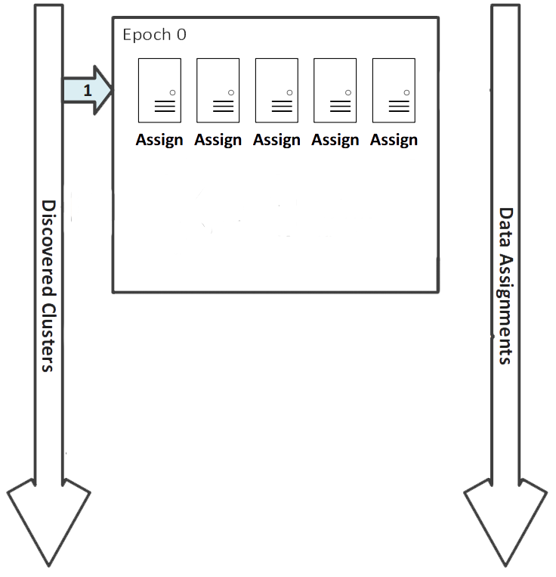
Parallel Assignment Step
Divide data into epoches
Assign in parallel
Save assignments
Gather new clusters
Merge similar clusters
Save merged clusters
Go to next epoch
Notes:
■To parallel the assignment step,
■we first divide the data assignment procedure into T epochs, each epoch assign a partition of the whole surfer dataset.
■then in each epoch, we assign the surfers into existing coalitions in parallel.
■After assignment, we save the result.
■Then we gather newly generated clusters from all assignment machines.
■Then since these new clusters could have redundancy, we use a validation procedure to merge similar clusters.
■Then save merged clusters together with existing clusters.
■And then go to next epoch.

Slide 21
Parallel Assignment Step Notes
The parallel algorithm is equivalent to the serial algorithm.
The validation step is the bottleneck of algorithm, we can skip it to speed up.
Notes:
■There are two notes, The parallel algorithm can be proved to be equivalent to the serial algorithm.
■Then After analysis, we found that the validation step is actually the bottleneck of the algorithm. So to further speed up the method, we can skip the validation step. Theoretical analysis about this approximation can be found in our paper.

Slide 22
Outline
Motivation
Characteristic Analysis
Detection Methods
Empirical Results
Conclusion
Notes:
■Now we are going to show some empirical results.

Slide 23
Synthetic Data Experiments
Label the data is hard, so we build a Synthetic Dataset to test the Recall performance.
Normal Part:
Simulate 1 million surfers and 100 thousand advertisers.
Each normal surfer randomly clicks 10 advertisers
Hit times are uniformly sampled from [1, 240]
Fraudulent Part:
Generate L coalitions, L at 100, 250, 500, 750 and 1,000.
each consists of 200 surfers and 5 advertisers
and assigns each advertiser a random hit time.
Notes:
■Because of the property of fraud detection, it is very hard to label a dataset. So we first build a synthetic dataset to test the recall performance of our method.
■The synthetic dataset composed by normal part and fraudulent part.
■For normal part, we simulate one million surfers and one hundred thousand advertisers. Each normal surfer randomly clicks ten advertisers. And the hit times are uniformly sampled from one to two hundred and forty.
■For the fraudulent part. We generate L coalitions, During experiments, we set L from one hundred to one thousand. Each coalition consists of two hundred surfers and five advertisers. And we assign each advertiser a random intrinsic hit time.

Slide 24
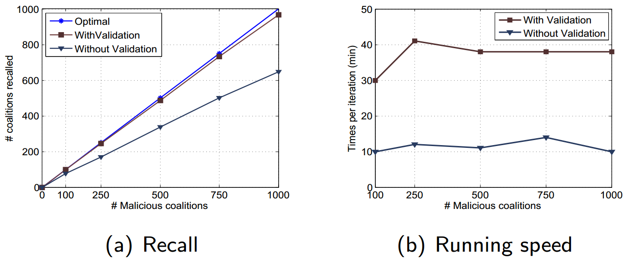
Synthetic Data Experiments
65%
3x~4x
82%
Number of discovered coalitions for both settings increase about linearly with the number coalitions.
Recall rates of the algorithm without validation are lower, but acceptable when coalitions are rare.
Notes:
■Here are the results, The first figure shows the number of discovered coalitions. We tested two settings, one with validation step and one without validation step.
We found that the number of discovered coalitions in both setting increase about linearly with the number of coalitions.
■For the method without validation, the recall rate is about eighty two percent when L equals to one hundred,
■and it reduced to sixty five percent when L equals to one thousand.
■This shows that although the recall rates of the algorithm without validation are lower, it is acceptable when the number of coalitions are relatively small.
■The second figure shows the comparison of running time. We can see the running speed of the method without validation is about three or four times faster.

Slide 25
Real World Data Experiments
One week data of advertisement click logs of a real Chinese commercial search engine.
398 million logs, 6.5 million unique IPs, 330 thousand unique advertiser Ids and 2.9 million unique queries.
Notes:
■Then we test our method without validation on a real world dataset, it is an one week dataset of advertisement click logs of a real Chinese commercial search engine.
■It contains three hundred and ninety eight million logs, among these logs, there are six point five million unique IPs, three hundred and thirty thousand unique advertiser IDs, and two point nine million unique queries.

Slide 26
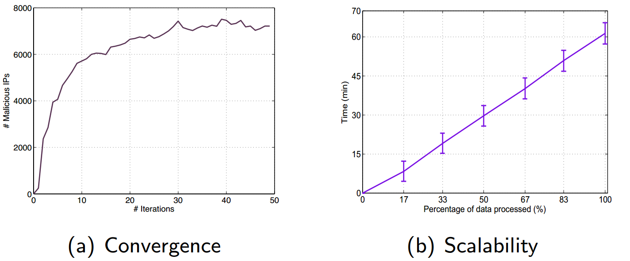
Convergence & Scalability
(a) shows the number of malicious IPs we found during iterating, converges after about 30 iterations.
(b) shows the overall running time after each epoch, increases about linearly.
Notes:
■First we show the result on convergence and scalability. The figure on the left shows the number of malicious IPs we found during iterating. We can see this number converges after about thirty iterations. This shows that although we skip validation, our method still converge well.
■The figure on the right shows the overall running time after each epoch of assignment stage. We can see it increases about linearly, which shows the scalability.

Slide 27
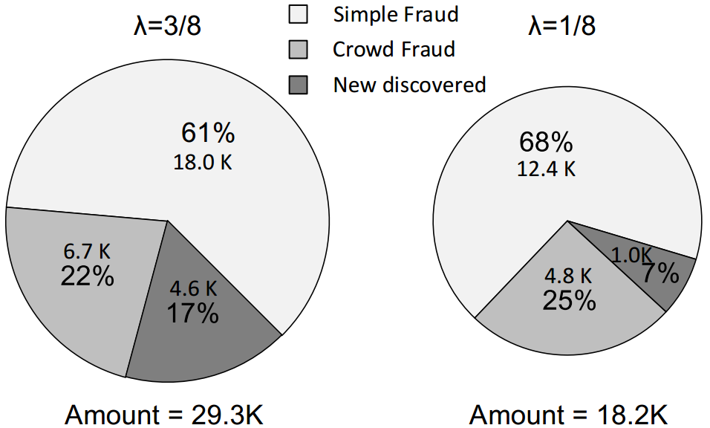
Accuracy
Found 231 malicious coalitions
After filtering, 210 coalitions are removed
29.3 K logs, 20 of the remain satisfy the dispersivity condition
Compared with commercial rule-based system.
200 new discovered logs are labeled by experts. 90% of them are crowd fraud.
Notes:
■For accuracy. After the clustering stage, we found two hundred and thirty one malicious coalitions, then after filtering stage. Two hundred and ten coalitions are removed.
■Then we examined the remain coalitions, twenty of them satisfy the dispersivity condition. All the remain coalitions corresponds to twenty nine point three thousand click logs.
■We compared our result logs with a commercial rule-based system. Then the result can be divided into three part.
■When lambda equals to three over eight, sixty one percent of the logs are confirmed to be simple fraud, which may induced by programs.
■Then twenty two percent logs are confirmed to be crowd fraud.
■The remain seventeen percent logs are new discovered. Since labeling is hard. We have experts to randomly select two hundred logs among them to label. The result shows that more than ninety percent of the subset are confirmed to be crowd fraud. When we change the lambda to be smaller, the accuracy will further improved. All these results show the efficiency of our method.

Slide 28
Outline
Motivation
Characteristic Analysis
Detection Methods
Empirical Results
Conclusion
Notes:
■Now come to the conclusion.

Slide 29
Conclusion
We formally analyze the crowd fraud problem for Internet advertising.
Notes:
■In this work, we formally analyze the crowd fraud problem for Internet advertising.

Slide 30
Conclusion
We formally analyze the crowd fraud problem for Internet advertising.
We present an effective method to detect crowd fraud.
Notes:
■We present an effective method to detect crowd fraud.

Slide 31
Conclusion
We formally analyze the crowd fraud problem for Internet advertising.
We present an effective method to detect crowd fraud.
We scale up the method for large-scale search engine advertising. Experiments on both synthetic and real world data show the effectiveness.
Notes:
■We scale up the method for large-scale search engine advertising. experiments on both synthetic and real world data show the effectiveness.

Slide 32
Thank You!
We formally analyze the crowd fraud problem for Internet advertising.
We present an effective method to detect crowd fraud.
We scale up the method for large-scale search engine advertising. Experiments on both synthetic and real world data show the effectiveness.
Tian Tian
rossowhite@163.com
Notes:
■We scale up the method for large-scale search engine advertising. experiments on both synthetic and real world data show the effectiveness.

