Slide 1


Fast Max–Margin Matrix Factorization with Data Augmentation
Minjie Xu, Jun Zhu & Bo Zhang
Tsinghua University

Slide 2
Matrix Factorization and M³F (I)
Setting: fit a partially observed matrix with
subject to certain constraints
Examples
  Singular Value Decomposition (SVD):
  when is fully observed, approximate it with the leading components (hence and minimizes -loss)
  Probabilistic Matrix Factorization (PMF):
  assume with Gaussian prior and likelihood (equivalent to -loss minimization with F-norm regularizer)
  Max-Margin Matrix Factorization (M³F):
  hinge loss minimization with nuclear norm regularizer on
  (or equivalently, F-norm regularizer on and )
(I)
(II)
observed entries

Slide 3
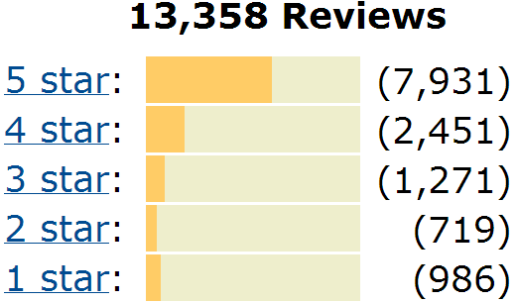
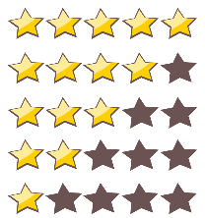
Matrix Factorization and M³F (II)
Benefits of M³F
  max-margin approach, more applicable to binary, ordinal or categorical data (e.g. ratings)
  the nuclear norm regularizer (I)
  allows flexible latent dimensionality
Limitations
  scalability vs. flexibility:
  SDP solvers for (I) scale poorly; while the more scalable (II) requires a pre-specified fixed finite
  efficiency vs. approximation:
  gradient descent solvers for (II) require a smooth hinge; while bilinear SVM solvers can be time-consuming
Motivations: to build a M³F model that is both scalable, flexible and admits highly efficient solvers.

Slide 4
Roadmap
M³F
Gibbs M³F
Data augmentation
Gibbs iPM³F

Slide 5
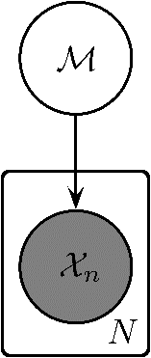
RRM as MAP, A New Look (I)
Setting: fit training data with model
Regularized Risk Minimization (RRM):
Maximum a Posteriori (MAP):
For discriminative models
feature
label
regularizer
empirical risk
posterior
prior
likelihood
loss function
discriminant function

Slide 6
RRM as MAP, A New Look (II)
Bridge RRM and MAP via delegate prior (likelihood)
  jointly intact: and induce exactly the same joint distribution (and thus the same posterior)
  singly relaxed: free from the normalization constraints (and thus no longer probability densities)
The transition:

Slide 7
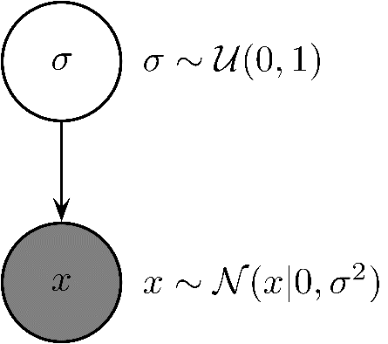
Delegate prior & likelihood
Consider a simplest case:
  genuine pair:
  delegate pair:
  can be completely different from when viewed as functions of the model
Both and are scaled (up to a constant) for better visualization.

Slide 8
M³F as MAP: the full model
We consider M³F for ordinal ratings
Risk: introduce thresholds and sum over the binary M³F losses for each
Regularizer: , where
MAP: with hyper-parameters
?

Slide 9
Data Augmentation for M³F (I)
Data augmentation in general
  introduce auxiliary variables to facilitate Bayesian inference on the original variables of interest
  inject independence:
  e.g. EM algorithm (joint);
  stick-breaking construction (conditional)
  exchange for a much simpler conditional representation:
  e.g. slice-sampling; data augmentation strategy for logistic models and that for SVMs
Lemma (location-scale mixture of Gaussians):
Gaussian density function

Slide 10
Data Augmentation for M³F (II)
Benefit of the augmented representation
  : Gaussian , “conjugate” to Gaussian “prior”
  : Generalized inverse Gaussian
  : inverse Gaussian

Slide 11
Data Augmentation for M³F (III)
M³F before augmentation:
where
and
M³F after augmentation (auxiliary variables ):
where

Slide 12
Data Augmentation for M³F (IV)
Posterior inference via Gibbs sampling
  Draw from for
  Draw from for
  Draw likewise for
  Draw from for
  For details, please refer to our paper

Slide 13





cross validation
Nonparametric M³F (I)
We want to automatically infer from data the latent dimensionality
The Indian buffet process
  induces a distribution on binary matrices with an unbounded number of columns
  follows a culinary metaphor
  e.g.
in an elegant way
behavioral pattern of the ith customer:
for kth sampled dish: sample according to popularity
then sample a number of new dishes

Slide 14
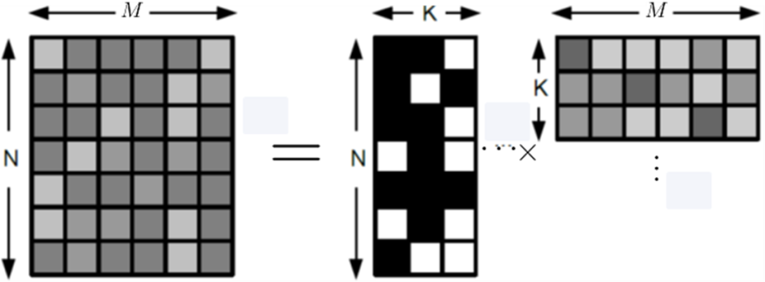
Nonparametric M³F (II)
IBP enjoys several nice properties
  favors sparse matrices
  finite columns for finite customers (with probability one)
  exchangeability → Gibbs sampling would be easy
We replace with and change the delegate prior
with hyper-parameters

Slide 15
Nonparametric M³F (III)
Inference via Gibbs sampling
  Draw from
  Draw from
  Draw from
  where
  Draw from
  Draw and

Slide 16
Experiments and Discussions
Datasets: MovieLens 1M & EachMovie
Test error (NMAE):
Training time:

Slide 17
Experiments and Discussions
Convergence:
  single samples vs. averaged samples
  RRM objective
  Validation error (NMAE)

Slide 18
Experiments and Discussions
Latent dimensionality:

Slide 19
Thanks!

