Slide 1
Fast Nearest Neighbor Search in the Hamming Space
OS3: Multimedia Machine Learning
Zhansheng Jiang, Lingxi Xie, Xiaotie Deng, Weiwei Xu, and Jingdong Wang

Slide 2
Nearest Neighbor Search
Nearest Neighbor (NN) Search
An optimization problem for finding the closest points for a particular query point from a set of reference data points.
Application
Large scale similar image search

Slide 3
Nearest Neighbor Search
Search in the Hamming Space
Multi-Index Hashing
FLANN
Fast Neighborhood Graph Search Using Cartesian Concatenation

Slide 4
Data Structure
Bridge Vectors
Similar to the concept of cluster centers in Product Quantization
Computed by k-means clustering for binary vectors
Minimize the average distance of each vector to its nearest bridge vector
Augmented Neighborhood Graph
Bridge graph – connect bridge vectors and their nearest reference vectors
Neighborhood graph – connect each reference vector to its nearest reference vectors

Slide 5
Compute Bridge Vectors
Defined as
K-means Clustering for Binary Vectors
Initialize centers randomly by the subvectors of reference vectors
assignment step: find the nearest center for the subvector of each reference vector
update step: optimize the centers for each cluster (by voting in each dimension)

Slide 6
Construct Augmented Neighborhood Graph
Bridge Graph
Find t nearest bridge vectors for each reference vector (by Multi-Sequence algorithm)
Keep b nearest reference vectors for each bridge vector
Neighborhood Graph
Find k nearest reference vectors for each reference vector
Approximate NN search method for large scale dataset

Slide 7
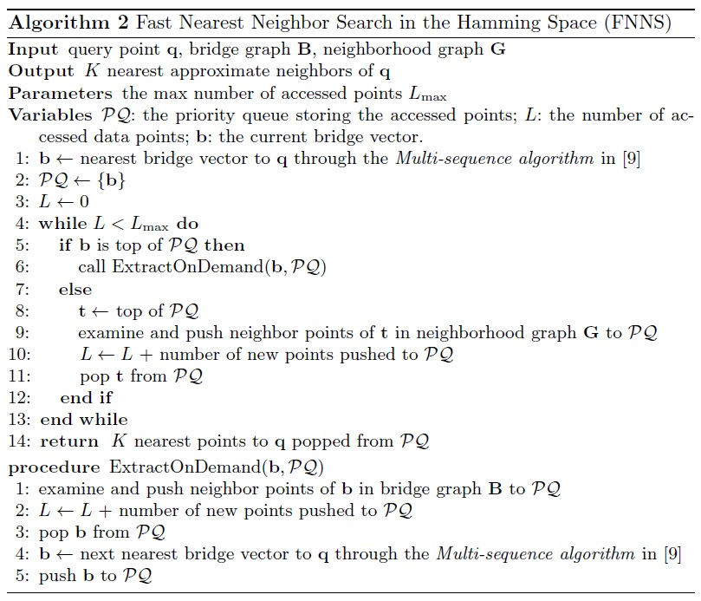

Slide 8
A
X
B
F
C
Y
I
E
D
Z
G
H
Query vector: white
Bridge vector: red
Reference vector: yellow

Slide 9
A
X
B
F
C
Y
I
E
D
Z
G
H
Push X
PQ = {X}
5NN = {}

Slide 10
A
X
B
F
C
Y
I
E
D
Z
G
H
Pop X and push ABCEF and Y
PQ = {ECFBYA}
5NN = {}

Slide 11
A
X
B
F
C
Y
I
E
D
Z
G
H
Pop E and Push D
PQ = {CDFBYA}
5NN = {E}

Slide 12
A
X
B
F
C
Y
I
E
D
Z
G
H
Pop C
PQ = {DFBYA}
5NN = {EC}

Slide 13
A
X
B
F
C
Y
I
E
D
Z
G
H
Pop D and push G
PQ = {FGBYA}
5NN = {ECD}

Slide 14
A
X
B
F
C
Y
I
E
D
Z
G
H
Pop F
PQ = {GBYA}
5NN = {ECDF}

Slide 15
A
X
B
F
C
Y
I
E
D
Z
G
H
Pop G and push H
PQ = {BHYA}
5NN = {ECDFG}

Slide 16
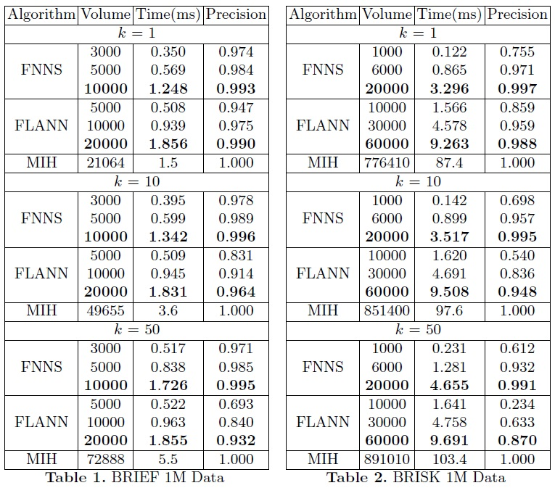

Slide 17
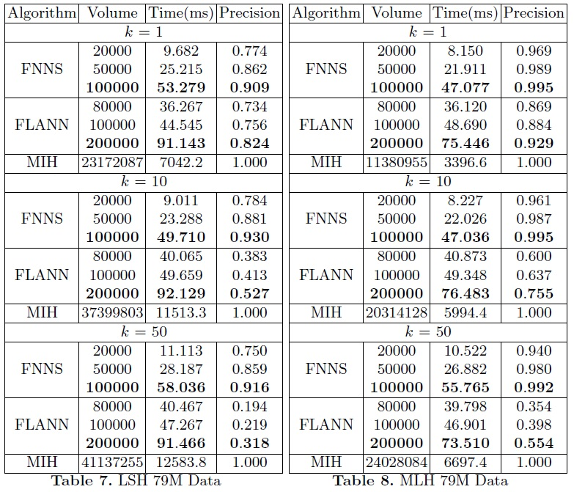

Slide 18
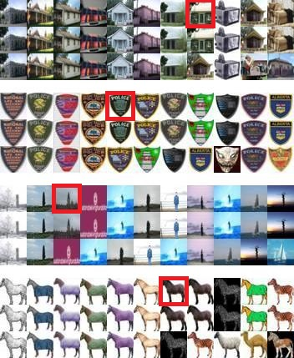
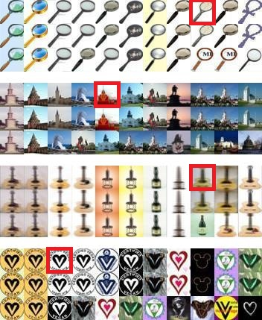

Slide 19
